Slide 1

guitariffic
web services

Slide 2
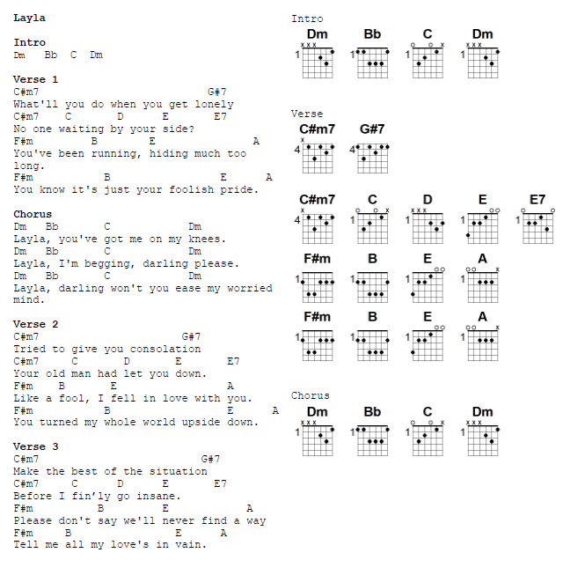
What are guitar fake sheets?
combination of lyrics, guitar charts, and other helpful information to play music

Slide 3
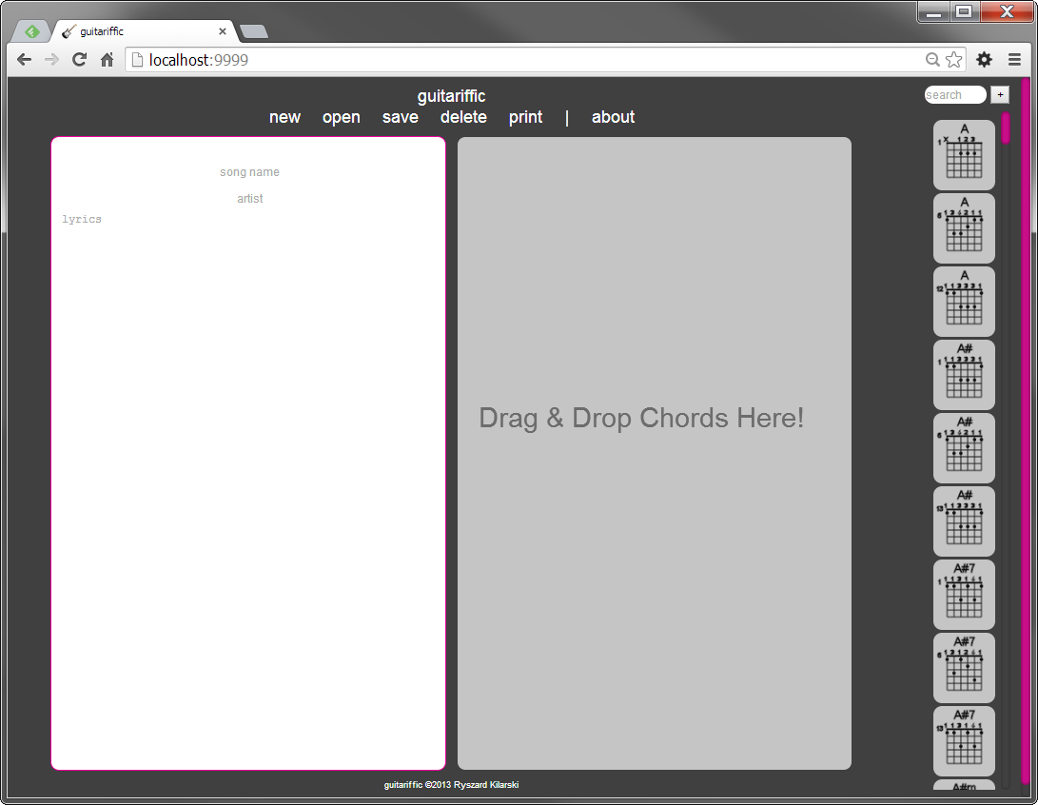
Guitariffic!

Slide 4
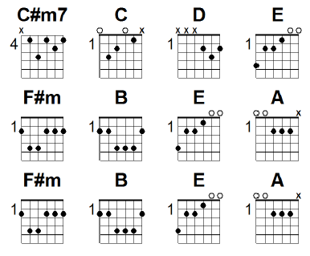
Chord charts
ability to add, edit, delete and search for chord charts

Slide 5
songs
ability to add, edit, delete, and search for songs… AND something extra

Slide 6
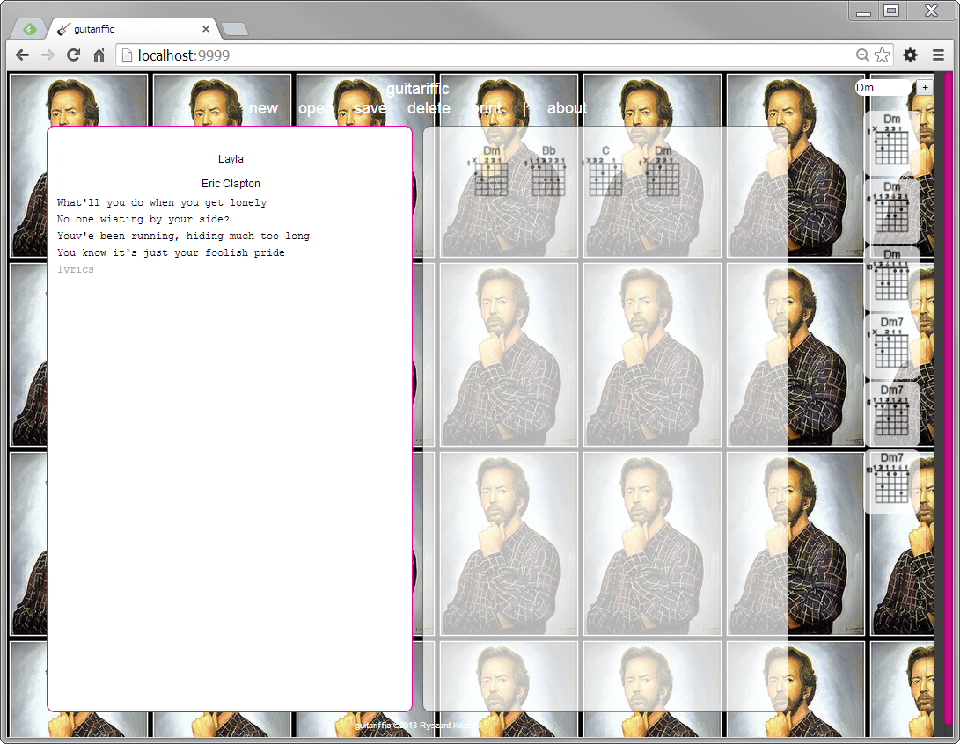
Flickr Images for background

Slide 7

Flickr services
song services
flickr
guitar chart services

Slide 8
Encapsulated image access layer
<<ImageImpl>>
SongServiceImpl
FlickrImageImpl
flickr
ImageImpl
GoogleImageImpl (future?)
Google images
swap image layer with different scheme; currently implemented with flickr only, via REST service

Slide 9
Encapsulated data access layer
<<GuitarChartDBHelper>>
*ServiceImpl
GuitarChartMemoryDBImpl
chords.xml
StorageFactory
GuitarChartSqlDBImpl
swap data layer with different scheme; currently implemented in-memory representation of charts and songs

Slide 10
Rest and soap services
rest test client, use SoapUI to test SOAP services

Slide 11
guitariffic ?

